Slide 1

Career Hacking: Becoming Job Ready
Latest important information when it comes to career planning.

Slide 2
The Career Cycle

Slide 3




The Career Cycle
Getting admission to the institute
Completing the Degree
Onboarding the career with a Job

Slide 4



The Career Cycle
Getting admission to the institute
Completing the Degree
Onboarding the career with a Job
Something is Missing !!!

Slide 5




The Career Cycle
Listing out the employers
Building a Profile
Resume Building
LinkedIn or other social media profiles
Appearing in interviews
Search & Applying for a few of them

Slide 6
The Career Cycle
Listing out the employers
Building a Profile
Resume Building
LinkedIn or other social media profiles
Appearing in interviews
Search & Applying for a few of them

Slide 7
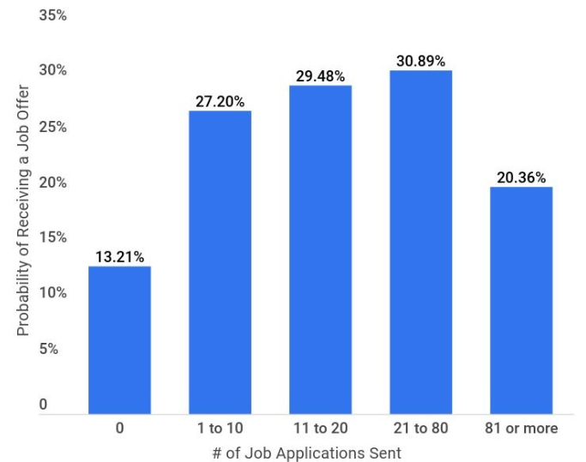
Facts about Job Application
21 to 80 applications for one offer
10 hours every week spent by seekers
61.7% gets interview call from 10 application
51% gets an offer after 3 interviews
Source: U.S. Bureau of Labor Statistics, Glassdoor, LinkedIn, and Career builder.

Slide 8

Resumes in the World of Automation
Software packages, Application Tracking Systems (ATS), or AI systems to look at your Resume
About 50-70% of the resume gets weeded out by these systems.

Slide 9



Stand out your Resume
Software packages, Application Tracking Systems (ATS), or AI systems to look at your Resume
It should be powerful
About 50-70% of the resume gets weeded out by these systems.
It must contain Keywords to pass through ATS systems

Slide 10
Core Skills
Your core skills are like the wheels of a car
1
2
3
4
Skill
Skill
Skill
Skill

Slide 11

Core Skills
Your core skills are like the wheels of a car
Labour Market experts know that people usually spend 6 seconds on your resume.
3
4
1
2

Slide 12
Core Skills
Labor Market experts know that people usually spend 6 seconds on your resume.
Your core skills are like the wheels of a car
Experts have developed eye-scanning techniques
3
4
1
2

Slide 13
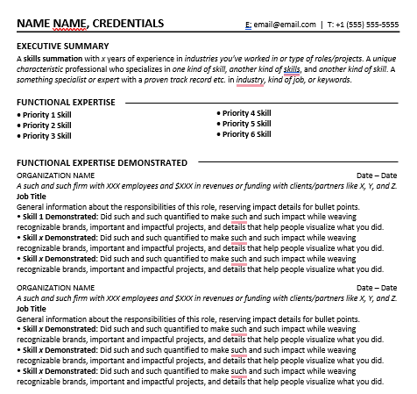
Core Skills
Labor Market experts know that people usually spend 6 seconds on your resume.
Experts have developed eye-scanning techniques
Their eyes tend to gravitate toward particular areas of your resume.

Slide 14
Core Skills
Their eyes tend to gravitate toward particular areas of your resume.
4
These areas on your resume should shout that I have the skills that your organization needs to thrive.
1
3
2

Slide 15

Core Skills
4
Place your relevant skills in these areas
1
3
2

Slide 16
Core Skills
1
2
3
4
Place your relevant skills in these areas
1
4
3

Slide 17


Let’s take an example!
Harry
is looking for a web developer role

Slide 18
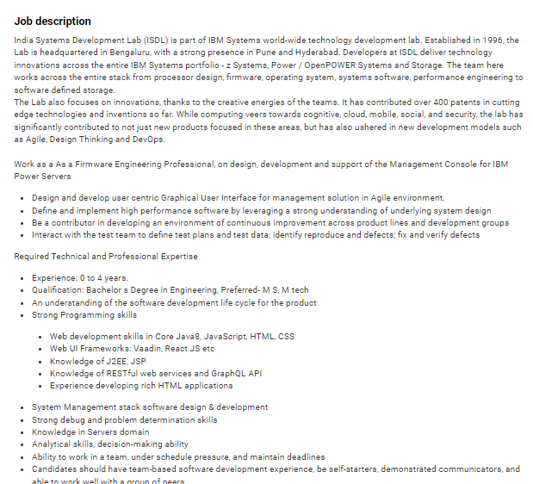
Let’s take an example!
He went online on a job portal to look for a job and checked the job description posted by the companies.

Slide 19
Let’s take an example!
He went online on a job portal to look for a job and checked the job description posted by the companies.
Designing
Agility
Testing
Decision Making
Team Player
Communicator

Slide 20
Let’s take an example!
Designing
Agility
Testing
Decision Making
Team Player
Communicator

Slide 21
Let’s take an example!
Now, harry will try to blend these skills with his natural skills and place them judiciously on his resume.
Designing
Agility
Testing
Decision Making
Team Player
Communicator

Slide 22
Activity!!!
Let’s reverse-engineer your skills.
Here are two sample job descriptions, draft the top Six Skills based on what you see. They don’t have to be written perfectly right now.
Click Here to Download Sample Job Descriptions

Slide 23
Activity!!!
Let’s reverse-engineer your skills.
1
Developing in a Team Environment
4
Object-Oriented Programming (Swift, Objective-C)
2
Designing and Building with APIs
5
Building and Maintaining Mobile Applications
Proficient with Software Development Life Cycle
3
Troubleshooting and Finding Bugs
6

Slide 24
Optimizing your Resume in the Age of Algorithms
Find matching language
Look for the keywords on job description
Identify the buzzwords
Look for buzzwords on websites or vision/missions
Use solid titles
Using solid relevant titles
Include relevant software
List some software which are applicable in desired role/industries
Take an audit of keywords
Track the repetition of keywords in your resume it shall be in line with top priority skill as in job description

Slide 25

Power of Language for Designing Content
Words draw pictures in the minds, like ‘sustainable energy’, projects images of solar panels, wind turbines, etc.…
Similarly using powerful words shows success and trust in action.
Supercharge the body content to build trust by:
Integrating Brands
Quantifications
Detailing

Slide 26
Power of Language for Designing Content
For example:
How you’d naturally say it:
“I helped develop an iOS app for a group of scientists.”
How you’d say it on a resume:
“Collaborated with a team of x to develop an iOS app for the [some science group or organization] which was successfully launched in [date] and downloaded xxx in the first x months.”
Brand Name
Powerful words
Quantification and Detailing

Slide 27
A Toolkit for Generating Powerful Words
Click here to download the toolkit

Slide 28
Activity!!!
Think about your most recent career-related experience. What part of that experience was most important?
Now, try to align what was most important in that experience with your highest-priority Six Skills. You may have to reframe the experience for it to fit the Skills. If it can’t align, move to a lower-priority skill.
When it does align, describe your part in that experience and integrate brands, quantities, and details into your description. Take notes of your work. This is a draft of bullet points that you can use on your resume.
Repeat this workflow going back to your career history for up to 10 years. Your goal is to have 2-3 bullet points for each experience listed on your resume. Each bullet point needs to align with one of your Six Skills.
If you can, you should try to find at least one bullet point for each of your Six Skills to include somewhere in your resume. However, sometimes this is not possible. It is essential that you are able to develop at least one bullet point for each of your top 3 Big Six Skills.

Slide 29
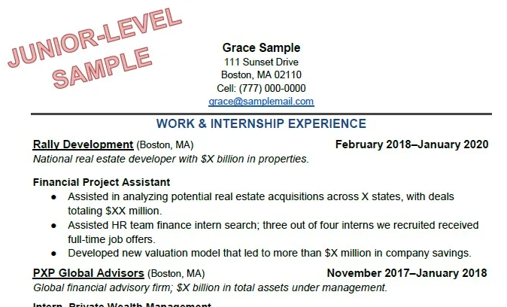
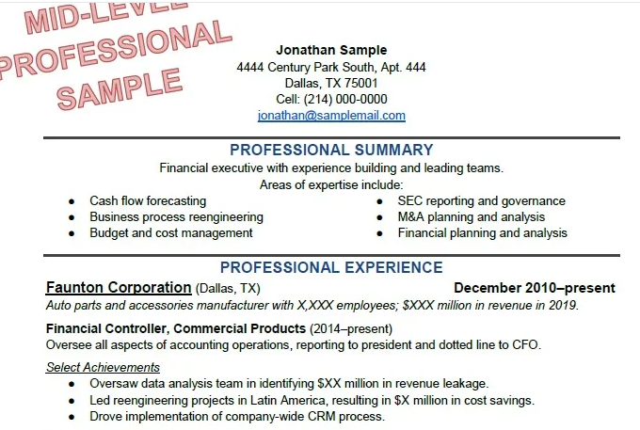
Activity!!!
Analyzing Data: Enabled the creation of a large Excel database built with data points gathered from the Securities and Exchange Commission (SEC) website on 200 publicly-traded companies and used the database to analyze the goodwill impairment calculations made by firms during the 2010s.
Analyzing Data: Enabled the creation of a large Excel database built with data points gathered from the Securities and Exchange Commission (SEC) website on 200 publicly-traded companies and used the database to analyze the goodwill impairment calculations made by firms during the 2010s.
Analyzing Data: Enabled the creation of a large Excel database built with data points gathered from the Securities and Exchange Commission (SEC) website on 200 publicly-traded companies and used the database to analyze the goodwill impairment calculations made by firms during the 2010s.
Analyzing Data: Enabled the creation of a large Excel database built with data points gathered from the Securities and Exchange Commission (SEC) website on 200 publicly-traded companies and used the database to analyze the goodwill impairment calculations made by firms during the 2010s.

Slide 30
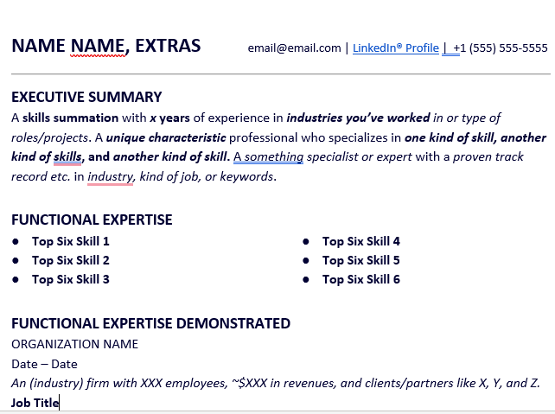

Writing the Summary
Your Resume must have a summary section crafted on the lines we discussed so far.
The top skills must be summarized in a way that it aligns with the role you are targeting.

Slide 31

Writing the Summary
Your Resume must have a summary section crafted on the lines we discussed so far.
The top skills must be summarized in a way that it aligns with the role you are targeting.
Josh, is working as a product manager at an organic food firm, let’s see, how he will modify the summary section

Slide 32

Writing the Summary
Josh, is working as a product manager at an organic food firm, let’s see, how he will modify the summary section
EXECUTIVE SUMMARY
A product managing expert with 4 years of experience in food processing and distribution. Specialized in managing the entire product life cycle from scratch.
EXECUTIVE SUMMARY
A skills summation with x years of experience in industries you’ve worked in or type of roles/projects. A unique characteristic professional who specializes in one kind of skill, another kind of skills, and another kind of skill. A something specialist or expert with a proven track record etc. in industry, kind of job, or keywords.
EXECUTIVE SUMMARY
A product managing expert with 4 years of experience in food processing and distribution. A unique characteristic professional who specializes in one kind of skill, another kind of skills, and another kind of skill. A something specialist or expert with a proven track record etc. in industry, kind of job, or keywords.

Slide 33

Final tips before Diving-in
Should you tell your life story in your Resume?
Keep your Resume on one page anyhow.
Yes
Yes
No
No
You must not leave any gaps in your education and employment on your resume.
Should you include non-paid jobs/volunteerism on your Resume
Yes
Yes
No
No
Should you include funky eye-catching email ID on your Resume.
Yes
No

Slide 34
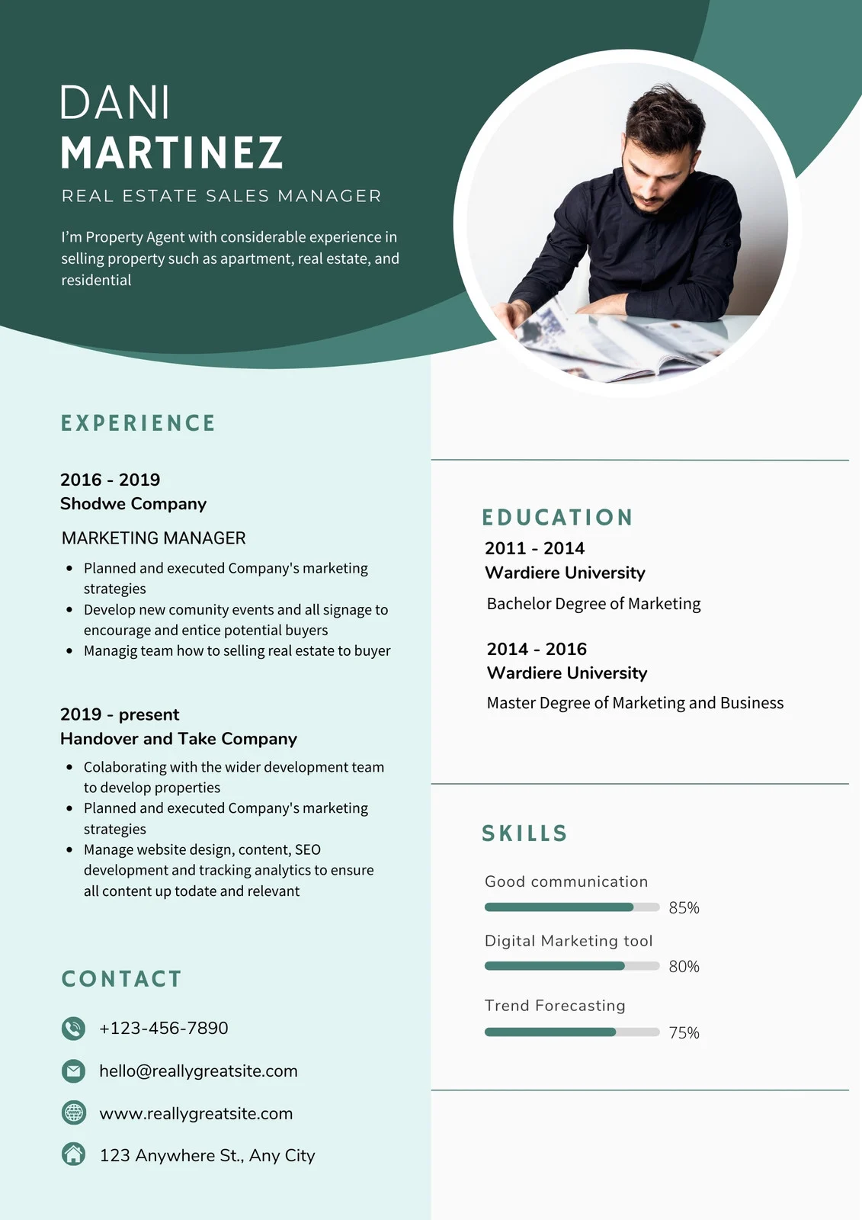
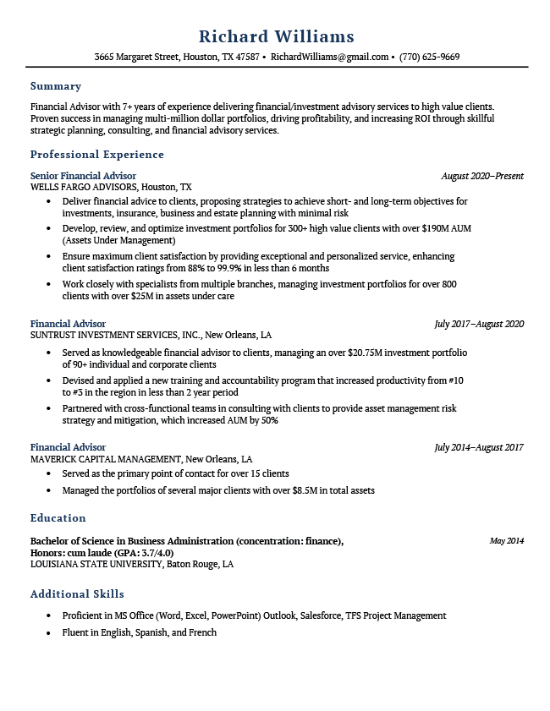


Step by Step Guide

Slide 35
Step by Step Guide
Prefer a more professional and simpler-looking format as this doesn’t distract the viewer from your content.

Slide 36
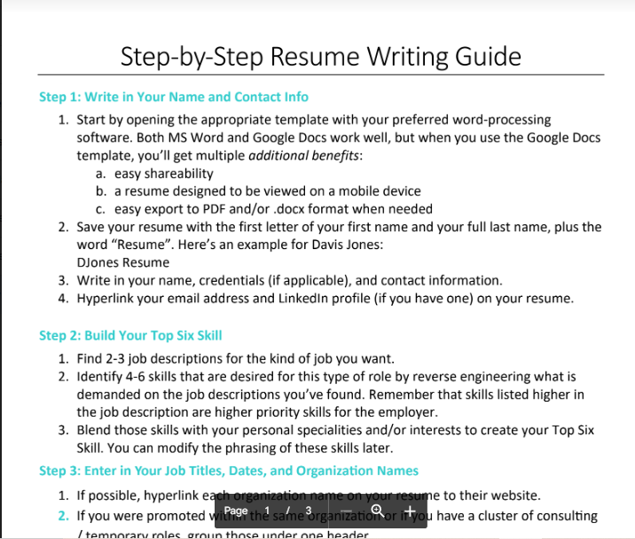
Step by Step Guide
Look at this step-by-step resume writing guide compiled for your ease and follow the instructions.
Click here to access this guide

Slide 37
Use the Template
For ease from layout and placement of the major content find the templates below and pick a suitable one.
Resume Template for General Use (Except freshers)
Resume Templates for Recent Graduates
Sample Resumes

Slide 38

Thank You !!
You have to learn the rules of the game and then you have to play it better than anyone else.
Albert Einstien

